Slide 1
How to Handle an
OSHA Inspection
Who You Gonna Call?
What You GoNna Do?

Slide 2

Meet the presenter
Scott
turner
Safety consultant
216-469-6600
scott.t.1@bwc.ohio.gov
PAT
Mcdonnell
Industrial hygiene (health) consultant
216-538-9722
patrick.m.1@bwc.ohio.gov

Slide 3
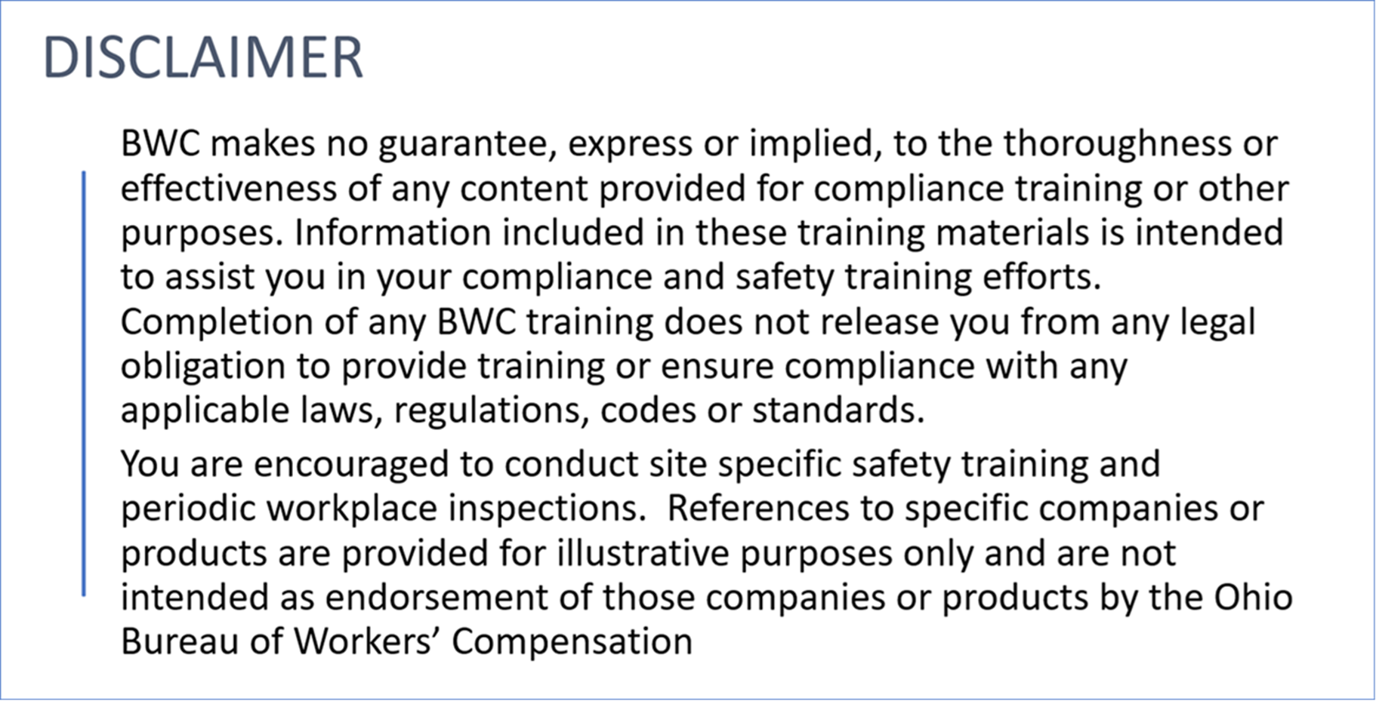

Slide 4
Who Exactly is OSHA?
Occupational Safety and Health Administration – Created in 1971
OSHA’s mission:
  To assure safe and healthful working conditions for working men and women by setting and enforcing standards and by providing training, outreach, education and assistance.

Slide 5
What Exactly is the OSHA Consultation Program?
We don’t issue citations.
Smaller employers in high hazard industries
No additional costs!
Employer controls the visit.
Employer may terminate the visit at any time.
Agree to correct “serious” hazards 40 days/extension.

Slide 6
Does Your Employer Know The Correct naics number?
North American Industrial Classification System
  www.naics.com

Slide 7
OSHA - Inspections, Citations & Proposed Penalties
Part 1903 at www.OSHA.gov
Each employer shall post/keep posted a notice (OSHA poster 8.5x14).
At the beginning of an inspection, compliance safety and health officers (CSHO) shall present their credentials to the owner, operator, or agent in charge at the establishment; explain the nature and purpose of the inspection; and indicate generally the scope of the inspection.

Slide 8
Part 1903
CSHO may consult with employees concerning matters of occupational safety and health to the extent they deem necessary to conduct an effective and thorough inspection.
During the course of an inspection, any employee shall be afforded an opportunity to bring any violation of the act which he has reason to believe exists in the workplace to the attention of the compliance safety and health officer.

Slide 9
PRIORITY OF OSHA INSPECTIONS
Priority | Category of inspection
1st | Imminent Danger Reasonable certainty an immediate danger exists
2nd | Fatality/Catastrophe Reported to OSHA; inspected ASAP
3rd | Complaints/Referrals Worker or worker representative can file a complaint about a safety or health hazard .
4th | Programmed Inspections Targeted inspections– Local Emphasis Program (LEP), National Emphasis Program (NEP)– industries and employers with high injury and illness rates, specific hazards, or other exposures
Notes:
Discuss this slide and possible follow up inspections as well. Also discuss that they could visit other facilities related to you our of state.

Slide 10
What Determines Programed Inspections?
Hint!
We have already discussed it!!!!

Slide 11
National Emphasis Programs
Combustible dust
Heat related hazards
Hexavalent chrome
Amputations – 6/30/2025
Falls

Slide 12
Local Emphasis Programs
Forklifts (1910.178)
Wooden pallet manufacturing (1910.213)
Grain handling facilities (1910.272)

Slide 13
Lep’s
Noise (1910.95) - may impact 1904 Recordkeeping
Food manufacturing (1910.212 and 1910.147)

Slide 14
NAICS - Food Manufacturing
3113** Sugar/confectionary product mfg.
3114** Fruit and vegetable preserving
3115** Dairy product mfg.
3116** Animal slaughtering and processing
3119** Other food mfg. (nuts, coffee/tea, spices)

Slide 15
What Employers Should Do If OSHA Visits!
Who to contact within the organization! (mgmt., safety person, private consulting firm, attorney).
Once credentials have been established take the CSHO person to a conference room.
OSHA must conduct an “opening conference” which lists purpose of their visit, employer rights and obligations.

Slide 16
What Employers Should Do!
If the CSHO wants to view a specific area of the facility (shipping/receiving, Press # 14) think about how to best get them there!
Do not offer any information/documents.
Only provide information/documents which the CHSO asks for.
If this is a formal complaint and there is information which will help to defend it, then provide that. (Noise complaint and you have evidence of a noise assessment).
Notes:
5

Slide 17
What Employer Reps Should Know!
Has your employer recently terminated anyone?
Current number of employees?
OSHA will ask about 1904 compliance. May ask for 3-5 years' worth of 300 logs/300A summary forms/301 accident reports
Is your employer required to submit injury/illness information electronically based on 1904.41?
Notes:
8

Slide 18
What Employers Should Do If OSHA Visits!
Have a clearly defined answer to internal safety management processes (assessments, training, safety team minutes).
OSHA CSHOs may determine that the employer is making a “good faith effort”.
If the CSHO visits a department and takes pictures, you take the same pictures from the identical angle/perspective!

Slide 19
Working With The OSHA Consultation Staff
May provide some level of protection
OSHA consultation staff have had a prior visit, and employer is within the 40 days of abating any “serious” hazards
Employer with settlement agreements
Rapid Response Investigations (1904.39 events)
We don’t call OSHA.
Notes:
8
Asking the students: Why is PPE so frequently ignored?

Slide 20
Top 10 OSHA Citations
Fall protection (construction) 1926.501
Hazard communication (general industry) 1910.1200
Ladders - 1926.1053
Scaffolding - 1926.451
Powered industrial trucks 1910.178
Notes:
FY23 Stats - Top 10 Most Frequently Cited Standards | Occupational Safety and Health Administration

Slide 21
Top 10 osha citations
Lock Out/Tag Out - 1910.147
Respiratory Protection - 1910.134
Fall Protection Training - 1926.503
Eye and Face Protection - 1926-102
Machinery and Machine Guarding – 1910.212
Notes:
FY23 Stats - Top 10 Most Frequently Cited Standards | Occupational Safety and Health Administration

Slide 23
Need more information?
Contact us for additional support and resources:
Scott
turner
216-469-6600
scott.t.1@bwc.ohio.gov
PAT
Mcdonnell
216-538-9722
patrick.m.1@bwc.ohio.gov

Slide 24

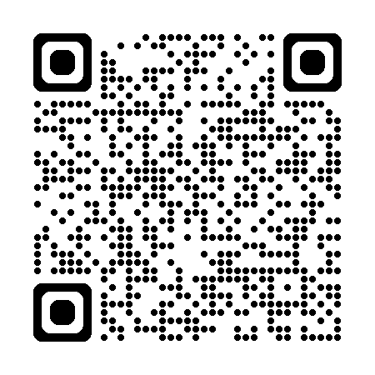
Office of safety services – we are here to help
On-site safety consultations
Workplace hazard assessments
Ergonomics and process safety reviews
Training and education courses
Grant opportunities for safety equipment

