Slide 1

Incident Investigations
Scott D. Cole, COSS, CSP
Corporate Safety and Quality Assurance Manager
scole@amhigley.com

Slide 2
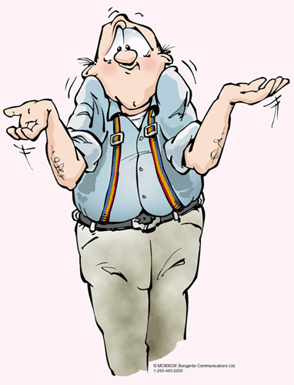
The “A” Word…
Accident versus Incident

Slide 3
Why Do We Investigate?
Determine why the failure(s) occurred
  Fact finding, NOT fault finding

Slide 4
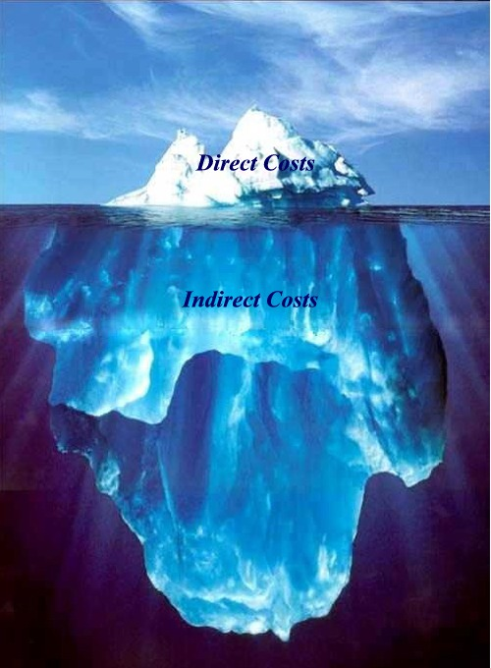
Iceberg Theory

Slide 5
10 Axioms of Industrial Safety
-H.W. Heinrich
Injuries result from a series of preceding factors.
Accidents occur as the result of a physical hazard or an unsafe act.
Most accidents are the result of unsafe behavior.
Unsafe acts and hazards do not always result in immediate accidents and injuries.
Understanding why people commit unsafe acts helps to establish guidelines for corrective actions.

Slide 6
The severity of the injury is largely fortuitous
and the accident that caused it is preventable.
The best accident prevention techniques are analogous to best quality / productivity techniques.
Management should assume safety responsibilities.
The supervisor is the key person in the prevention of industrial accidents.
Cost of accidents include both direct costs and indirect costs.

Slide 7
Heinrich Continued…
The Origins of Accidents
  88% - unsafe acts of persons
  10% - unsafe physical conditions
  2% - AOG
Domino Theory

Slide 8
Multicausal Theory
Two contributing factors of all incidents:
  Immediate
    Directly associated with the incident
  Basic
    Deficiencies associated with the management system

Slide 9

Cole’s Law
Always thinly slice cabbage

Slide 10
When Do We Investigate?
The key difference in an incident which results in an injury and one that doesn’t is often luck!
Investigate every incident, no matter how small

Slide 11
Who Should Investigate?
Supervisor
Safety Professional
Safety Committee (peer investigation)
Training, training, training…

Slide 12
8 Steps to a Thorough Investigation
Prepare for the Investigation
Gather the Facts
Analyze the Facts
Develop Conclusions
Write a Report
Recommend Corrective Actions
Correct the Situation
Follow-Up on Recommendations

Slide 13
Prepare for the Investigation
Establish a notification system
Identify / establish emergency services
Establish emergency shutdown procedures
Training
  How to conduct an investigation
  Identifying immediate and basic causes
  Documentation
Written program and report form
Incident investigation toolbox

Slide 14
Gather the Facts
Immediately
  Identify and interview witnesses
  View the area
  Take photographs, create drawings
  Collect evidence
    Noise levels, weather conditions, light conditions, etc.
  Gather documentation

Slide 15
Analyze the Facts
Be sure the information accurate

Slide 16
Develop Conclusions
What happened?
How did it happen?
Why did it happen?
All conclusions must be made on fact, not speculation

Slide 17
Conclusions Continued…
Immediate Causes
  PPE
  Safe Work Practices
  Guarding
  Housekeeping
  Equipment Failure

Slide 18
Conclusions Continued…
Basic Causes
  Knowledge and/or Training
  Supervision
  Engineering Practices
  PPE
  Maintenance Programs
  Equipment Selection
  Feedback Systems
  Practices and/or Procedures

Slide 19
Write a Report
Standardized report
Everything must be supported by fact and evidence
Clear, concise, free from extraneous information
Include photographs, drawings, witness statements, etc.

Slide 20
Recommend Corrective Actions
All basic causes must have corrective actions
  Management needs to assign a person responsible and establish a measurable timeframe (deadline) for completion
Correct the Situation

Slide 21
Follow-Up on Recommendations
Safety Action Items
AI #: | Priority: | Safety Action Item: | Responsible Employee: | Target Completion Date: | Actual Completion Date:
A=Emergency - Will Cause A Loss If Not Corrected
B=Needs Corrected Immediately But Not An Emergency
C=Cannot Cause Damage Or Injury But Still Needs Corrected

Slide 22
Step 9 - Bonus Round!
Incident Analysis and Data Collection

Slide 25
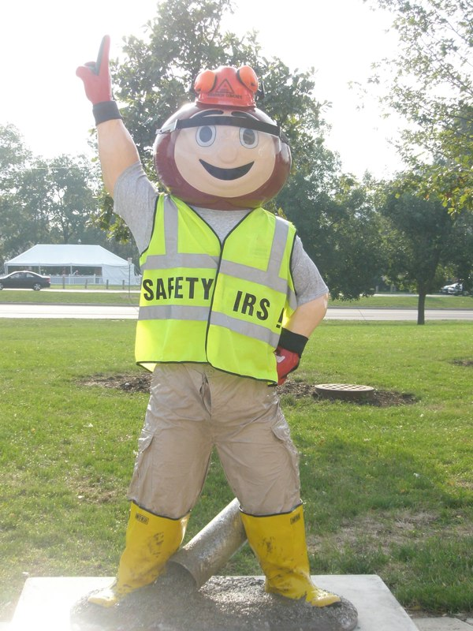
Questions?
Thank you for your attention.

